Slide 1





INTERN PE
OASIS
INFOBYTE
JAVA
INTERNSHIP
SLIDE PRESENTATIONS DESIGN
BY PRASHANT

Slide 2


CONTENT
Title Page
About Java Programming
01
02
Overview of Front page
Introduction of java Programming & its features
Intern Pe
Internship 1:- Basic Level
03
04
Abstract of the company and task
duration
About the basic of Java programming
Oasis Infobyte
Internship 2:-Intermediate level
05
06
About the company and assignment
tenure
Number Guessing Game & ATM Interface
Summary
Thank You
07
08
Key point of both Internships
Issuse ,Experience Learing......

Slide 3

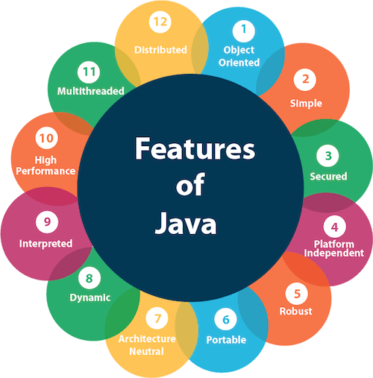

About Java Programming
•Java is an Object-oriented programming language
•It was developed by James Gosling and first released by Sun Microsystems in 1995.
•It is a fast, secure, reliable programming language for coding everything from mobile apps and enterprise software to big data applications and server-side technologies.
Java is secure and enables the development of virus-free, tamper-free systems

Slide 4



Java Basic
Syntax Rules
Variables & Data Types
Expressions & Operators
Loops & Conditionals
Java follows a strict set of syntax rules that must be followed in order for programs to work.
Understanding variables and data types is essential for working with Java.
Expressions and Operators make up the logic that Java follows.
Loops and conditionals are used to manipulate data and control the flow of Java program.

Slide 5




Intern Pe
Intern Pe
Outcomes & Lessons Learned
01
03
Internpe is a company, That is non-profitable and only focuses on your dreams. So let's start your Internship journey with us.
Learned the basics and Developed fundamental Java skills, improved teamwork and communication.
Internship Details
02
Program length: 4 weeks virtual internship programm. Focus on Java basics such as syntax, operators, and conditionals alongside team-based projects.

Slide 6

INTERN PE
Internship 1: Basic Level Java Programming
Tasks
To be performed
Create an Infinite Loop
Create an Executable Comment
Create a Named Loop
Use a while loop to create an infinite loop in Java.
Use the 'for' loop syntax to create a named loop in Java.
Use a while loop to create an infinite loop in Java.
Find a Single Duplicate
Find a Non-Unique Duplicate
Rock, Paper & Scissors Game
Write a Java method to find a single duplicate in an array of integers.
Write a Java method to find a non-unique duplicate in an array of integers.
Build a simple Java program to play the classic game of rock, paper, scissors.

Slide 7
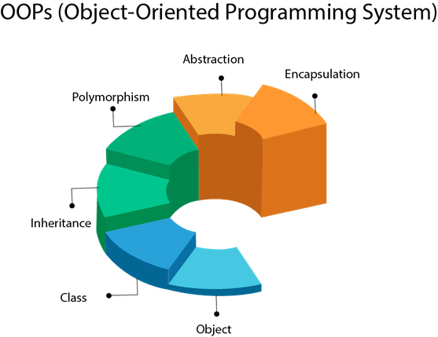
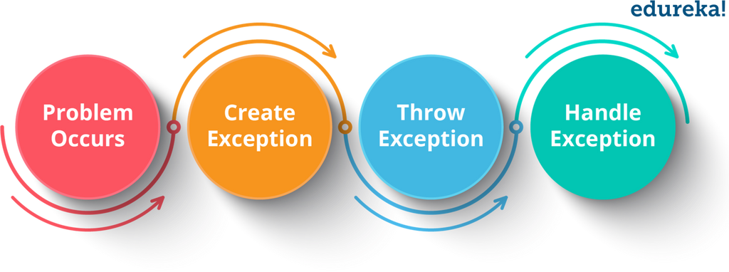
Java Programming Intermediate Level:
An Overview
Object-Oriented Programming
Object-oriented programming is an essential part of Java development.
Advanced Java Concepts
The intermediate level teaches advanced concepts such as exception handling, file I/O, and multithreading.

Slide 8
Welcome To Oasis Infobyte
OASIS INFOBYTE
Program length: 4 weeks. Focus on Java basics such as syntax, operators, and conditionals alongwith Intermediate Level Java Programming
OASIS INFOBYTE is a community of diverse people coming together with similar objectives and ultimate goals.
OASIS INFOBYTE is all about creating opportunities for leadership development, learning, student engagement, and fostering of shared interests. We develop enriching environments and experiences that promote students' knowledge and wellbeing

Slide 9




About Tasks
OASIS INFOBYTE
Intermediate Java Programming: Fun Projects to Build
01
NUMBER GUESSING GAME
Build a console-based number guessing game with Java. Challenge the user to guess a randomly generated number within a certain number of guesses.
02
ATM INTERFACE
Build a simple ATM interface with Java. Create a program that allows the user to check their balance, deposit or withdraw funds, and view recent transactions.

Slide 10





STUDIO SHODWE
SUMMARY
Henrietta Mitchell
Henrietta Mitchell
Hannah Morales
Francois Mercer

Slide 11

STUDIO SHODWE
Thank You
SLIDE PRESENTATIONS DESIGN
BY PRASHANT

